Slide 1
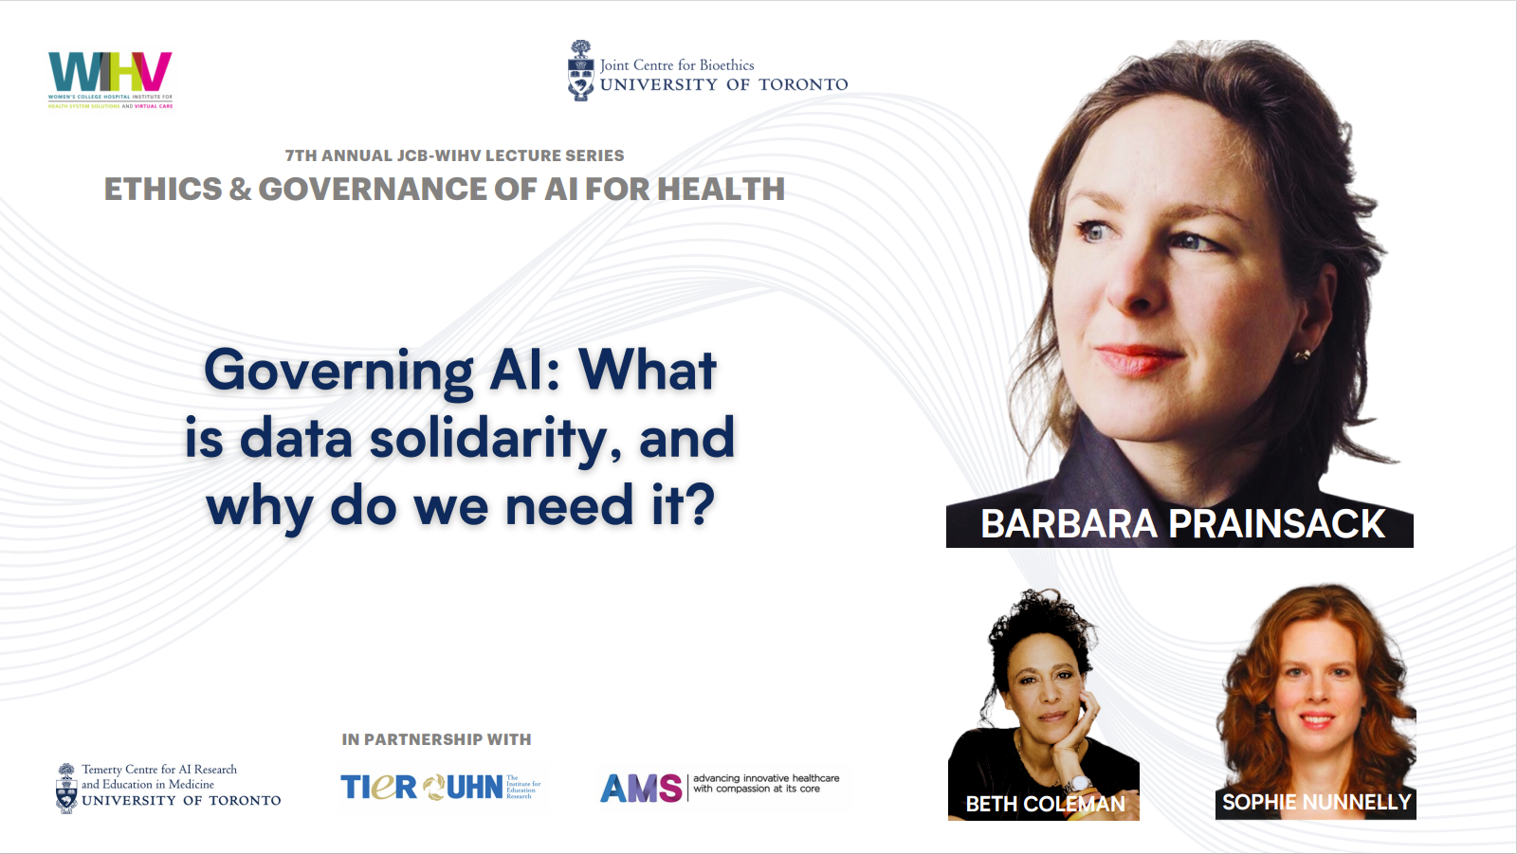

Slide 2
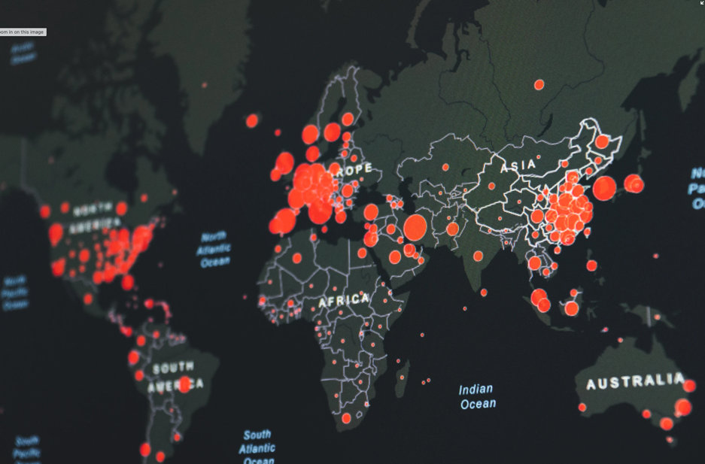
Governing AI: What is data solidarity, and why do we need it?
Barbara Prainsack
Professor, Department of Political Science, and Research Plattform Governance of Digital Practices, University of Vienna
Honorary Professor, Sydney Center for Healthy Societies, University of Sydney
Chair, European Group on Ethics in Science and New Technologies (EGE)
[image: Martin Sanchez @unsplash]

Slide 3
CoI
Chair, European Group on Ethics in Science and New Technologies (independent advisory body to the President of the European Commission and the College of Commissioners)
Member, Austrian National Bioethics Commission

Slide 4
Learning outcomes
1. Understand AI ethics and regulation as a political endeavour
2. Understand how ethical AI governance depends on good data governance
3. Understand the key principles of data solidarity, and what types of policy instruments are needed to realise it

Slide 5
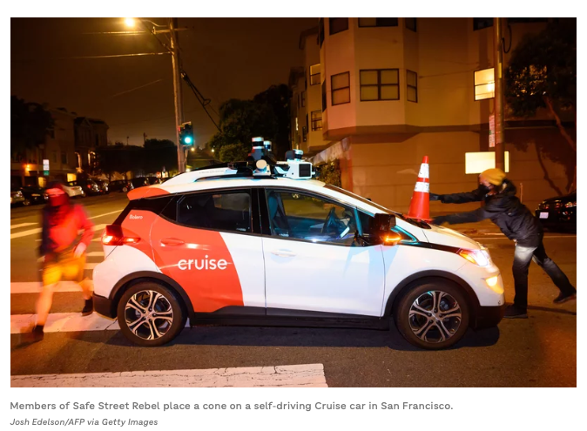
1. What is the problem?
[https://www.npr.org/2023/08/26/1195695051/driverless-cars-san-francisco-waymo-cruise]

Slide 6
[https://www.pharmaccess.org/our-approach/]

Slide 7
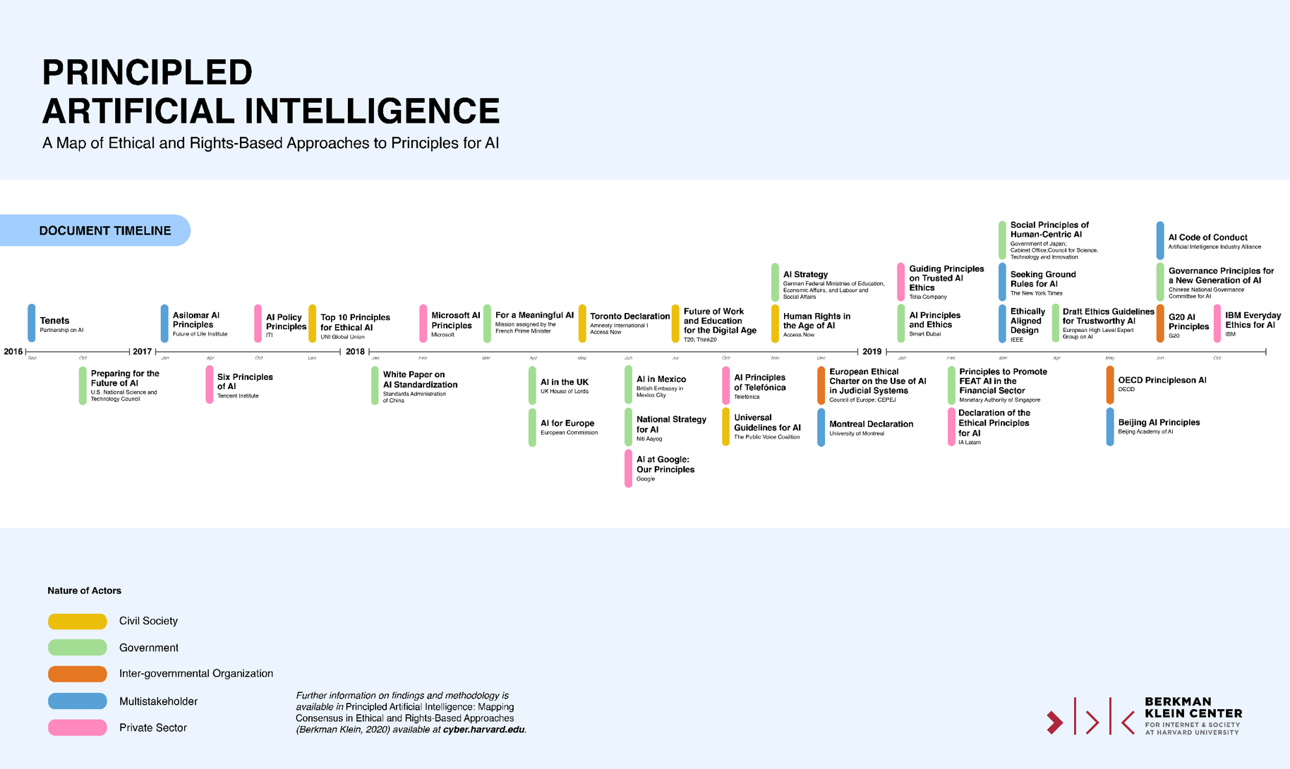

Slide 8
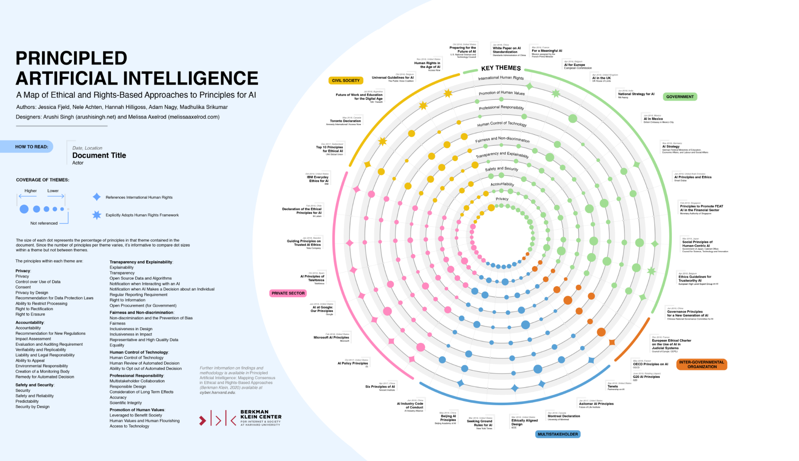
[https://wilkins.law.harvard.edu/misc/PrincipledAI_FinalGraphic.jpg]

Slide 9
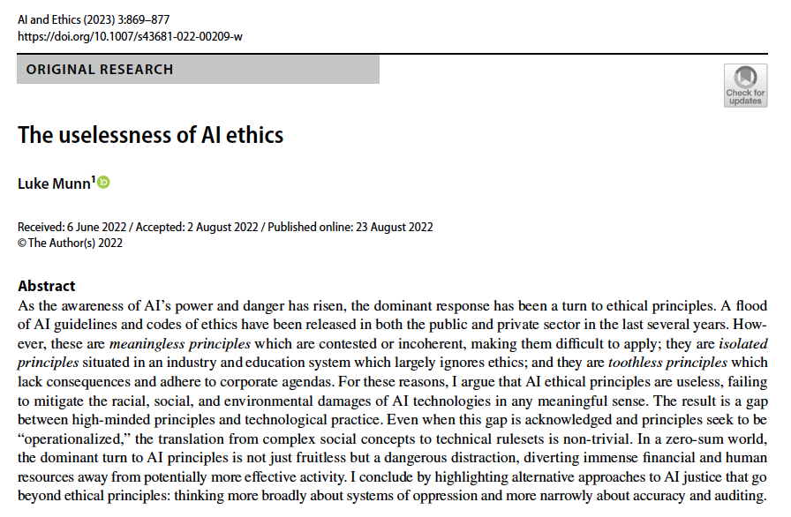

Slide 10
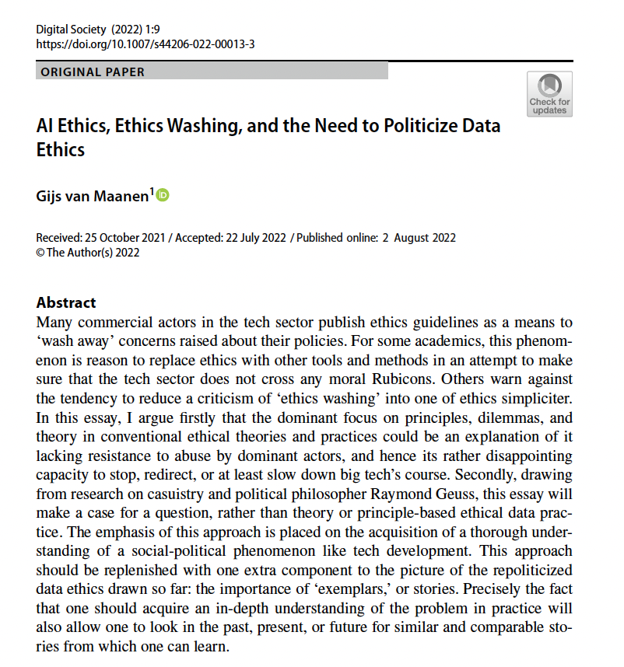
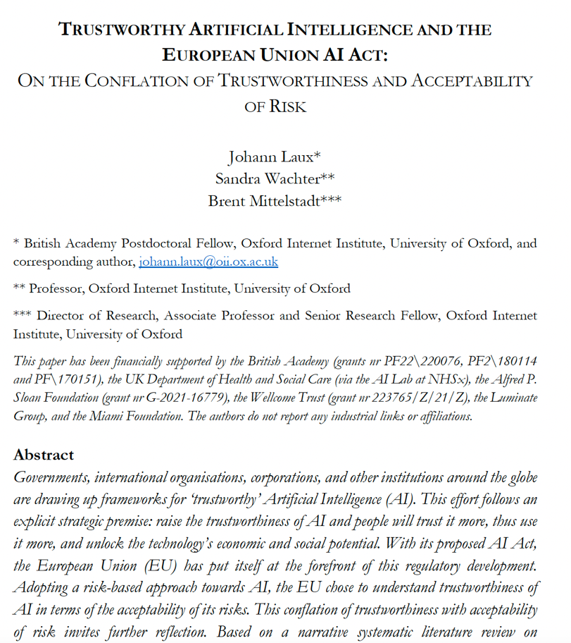

Slide 11
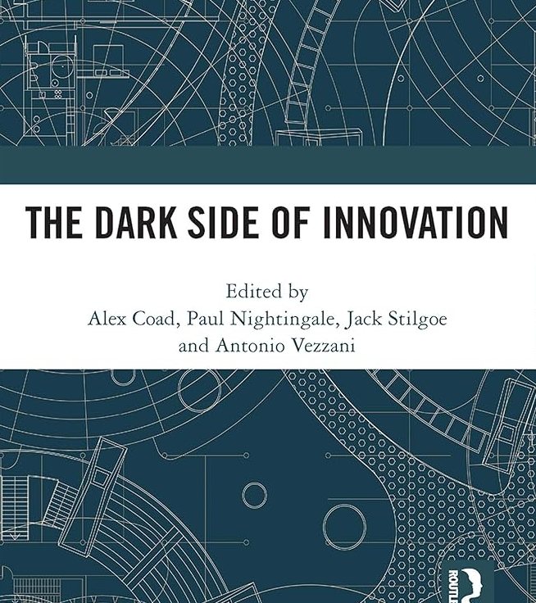
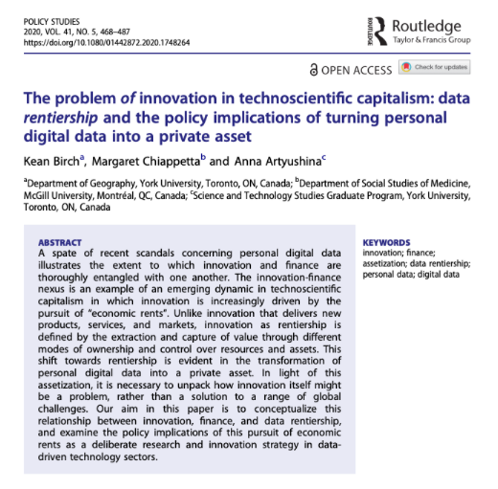

Slide 12
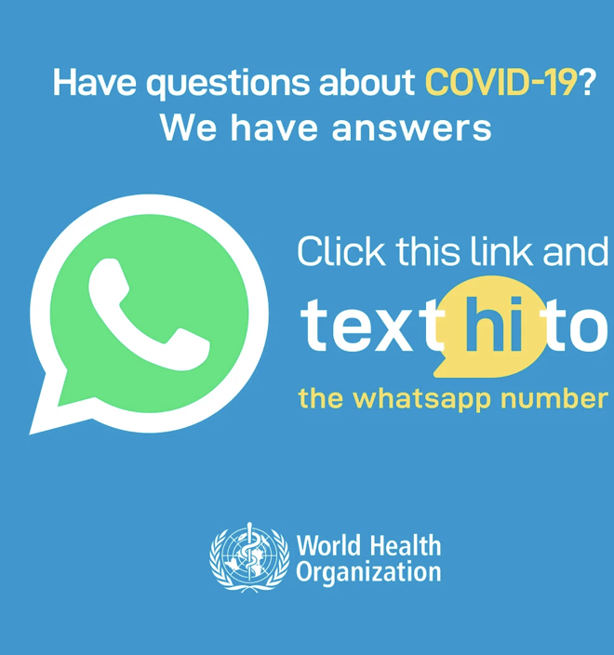
[Sharon, T., 2021. Blind-sided by privacy? Digital contact tracing, the Apple/Google API and big tech’s newfound role as global health policy makers. Ethics and Information Technology, 23(1), pp.45-57.]
[Hoeyer, K., 2020. Data promiscuity: How the public–private distinction shaped digital data infrastructures and notions of privacy. Humanities and Social Sciences Communications, 7(1), pp.1-8.]
[Prainsack, B., 2020. The political economy of digital data: introduction to the special issue. Policy Studies, 41(5), pp.439-446]

Slide 13
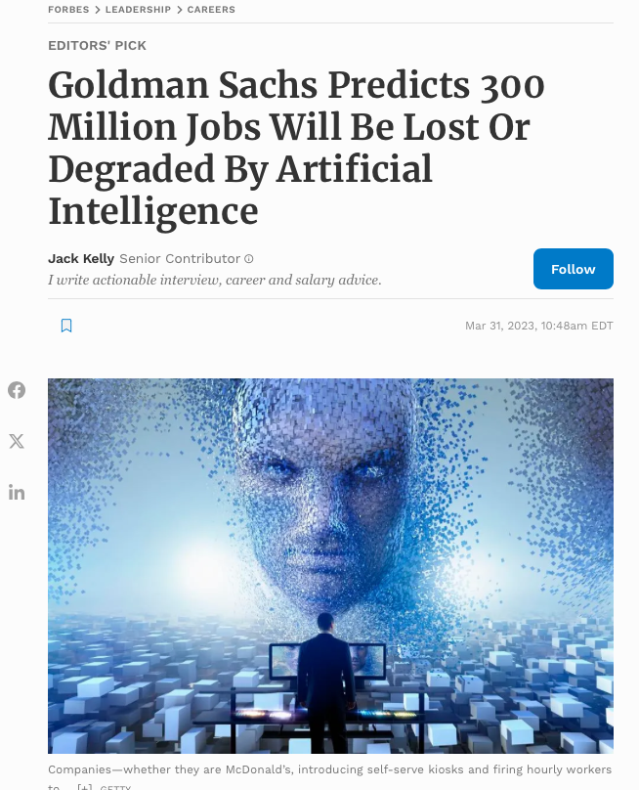

Slide 14
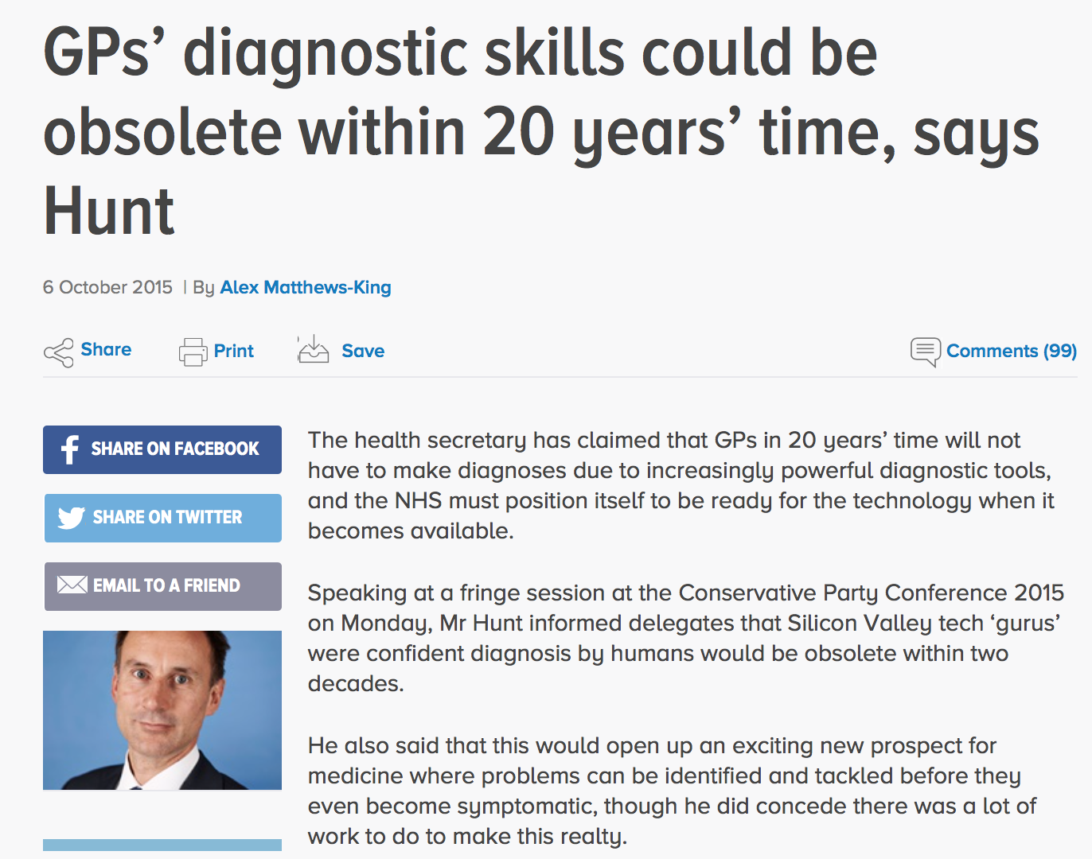
“You can get 300,000 biomarkers from a single drop of blood, so why would you depend on a human brain to calculate what that means when a computer can do it for you?”
[then UK Health Secretary Jeremy Hunt, quoting ‘technology developers in California’]
Notes:
‘If you talk to technology gurus in California and ask what’s going to change in the next two decades, they say “in 20 years’ time, no doctor will ever give a diagnosis”. They say “You can get three hundred thousand biomarkers from a single drop of blood, so why would you depend on a human brain to calculate what that means when a computer can do it for you?”.
I think it’s really important that we’re ready in the NHS to harness the power of data to give us more accurate diagnoses, in particular with that example.
He added: ‘What’s happened in medicine for the last two millenia is that you wait until you have a symptom and then a doctor tries to interpret the symptom.
’What this will mean, is we can identify problems before they’re symptomatic and therefore have a much better chance of tackling them. So it’s a pretty exciting prospect but there’s lots of work to do.’
Heavy investments in digital technologies

Slide 15
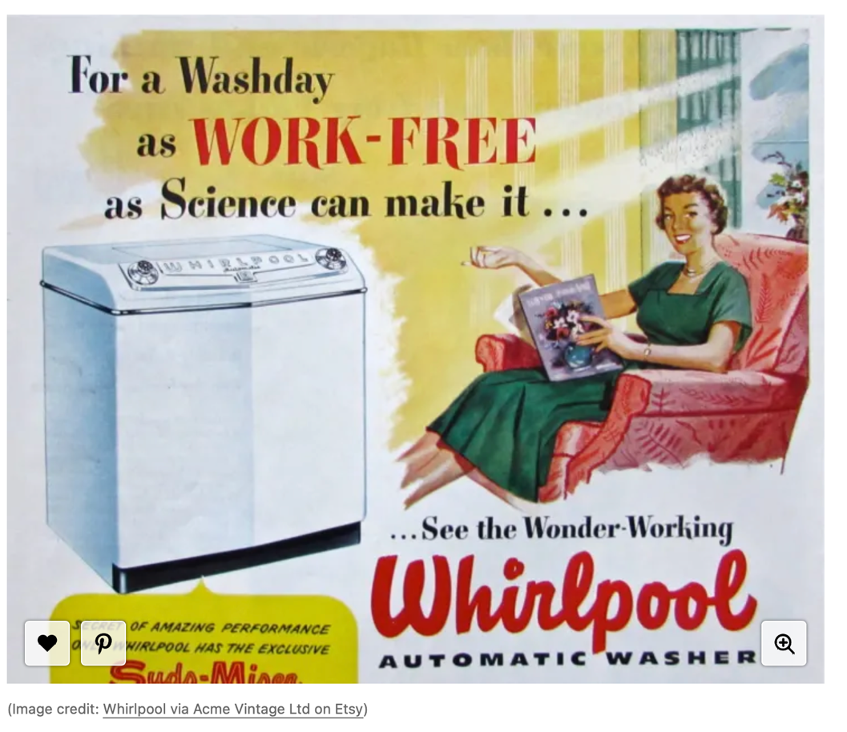

Slide 16
2. Moving out of the paper age: Towards a different data ontology

Slide 17
No protection for secondary data subjects
[image: https://algorithmwatch.org/en/projects/]
[Taylor, M., 2012. Genetic data and the law: a critical perspective on privacy protection. Cambridge University Press.]

Slide 18
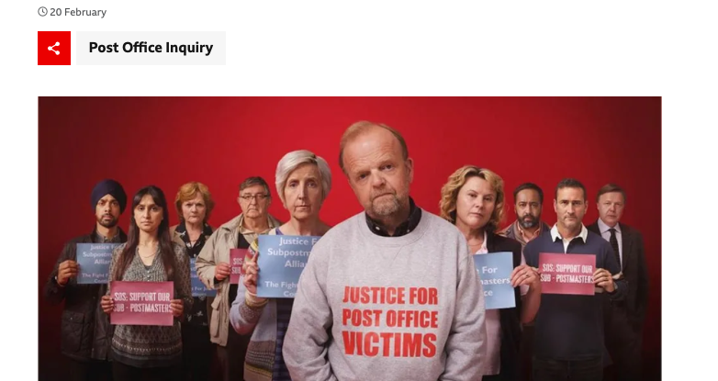
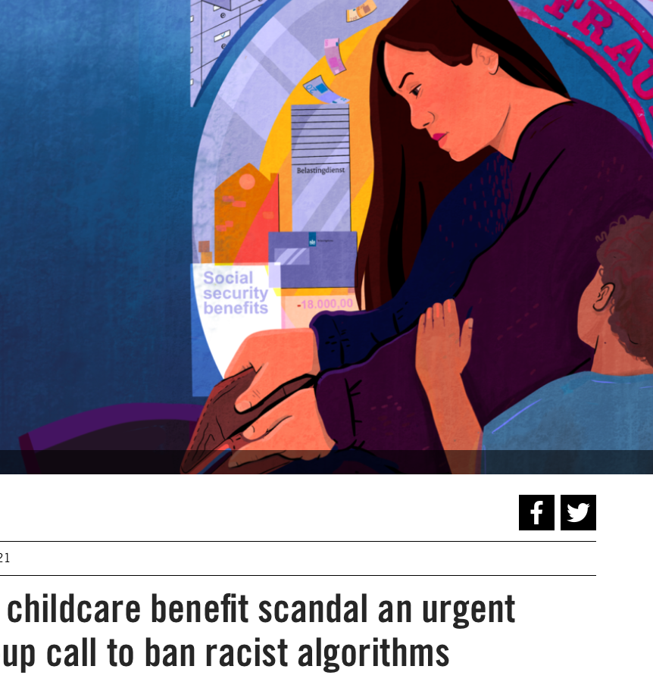

Slide 19
Three pillars of data solidarity
I. Facilitating data use that creates significant public value
III.
Sharing commercial profits with people and communities
II.
Harm prevention and mitigation
[Prainsack B. 2017. Research for personalised medicine: Time for solidarity. Medicine and Law 36(1): 87-98]

Slide 20
When does data use have public value?
‘if it can be plausibly assumed that the data use will have clear benefits for either many [people], for society as a whole, or for future generations, and no person or group will experience significant [and undue] harm.
[…public value] is more pronounced if the benefits are likely to materialise for underprivileged groups than for privileged people, due to the overall lower baseline, and potential size of impact’ ]
[Prainsack & Buyx. 2016. Thinking ethical and regulatory frameworks in medicine from the perspective of solidarity on both sides of the Atlantic. Theoretical Medicine and Bioethics 37(6): 489-501, 493.
See also Prainsack & Buyx. 2017. Solidarity in Biomedicine and Beyond. CUP. p 97]

Slide 21
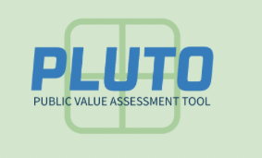
[https://pluto.univie.ac.at]

Slide 22
Please contact: Connor.hogan@univie.ac.at

Slide 23
From data types to data use
[Barbara Prainsack, Seliem El-Sayed, Nikolaus Forgó, Lukasz Szoszkiewicz, and Philipp Baumer. White Paper Data Solidarity (online)]
[Prainsack, B., El-Sayed, S., Forgó, N., Szoszkiewicz, Ł. and Baumer, P., 2022. Data solidarity: a blueprint for governing health futures. The Lancet Digital Health, 4(11), pp.e773-e774.]

Slide 25
Thank you for your attention!

